Slide 1

Azure Fundamentals
UNIT- 2
Azure Services

Slide 2
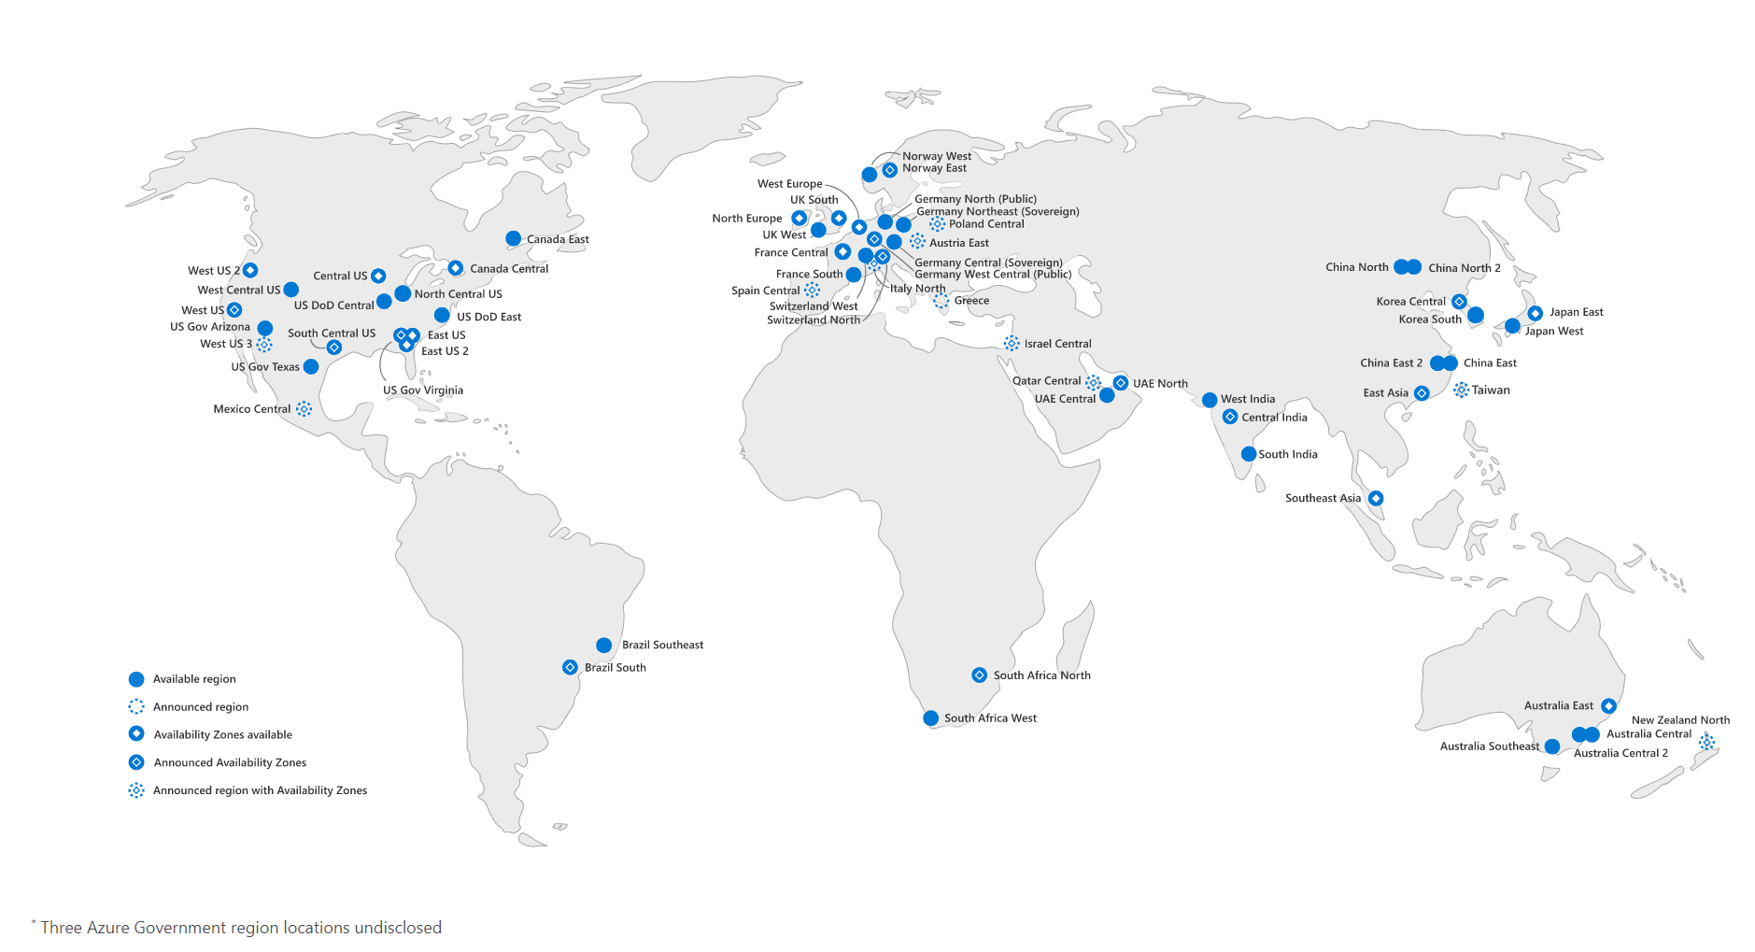
Azure Architectural Components
Regions
A region is a geographical area on the planet that contains one, or multiple datacenters that are nearby and connected with a low-latency network. When you deploy a resource in Azure, you'll need to choose the region where you want your resource deployed.

Slide 3
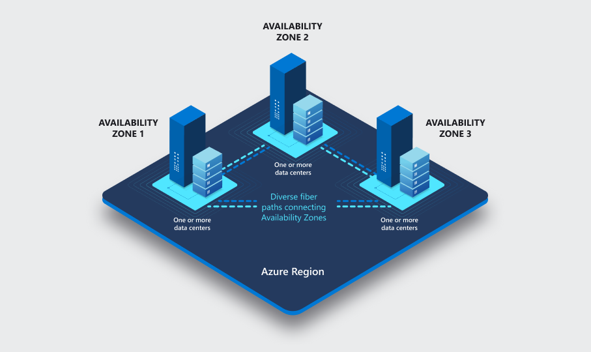
Azure Architectural Components
Availability Zones
Availability zones are physically separate datacenters within an Azure region.
Each availability zone is made up of one or more datacenters equipped with independent power, cooling, and networking.
An availability zone is set up to be an isolation boundary. If one zone goes down, the other continues working.

Slide 4
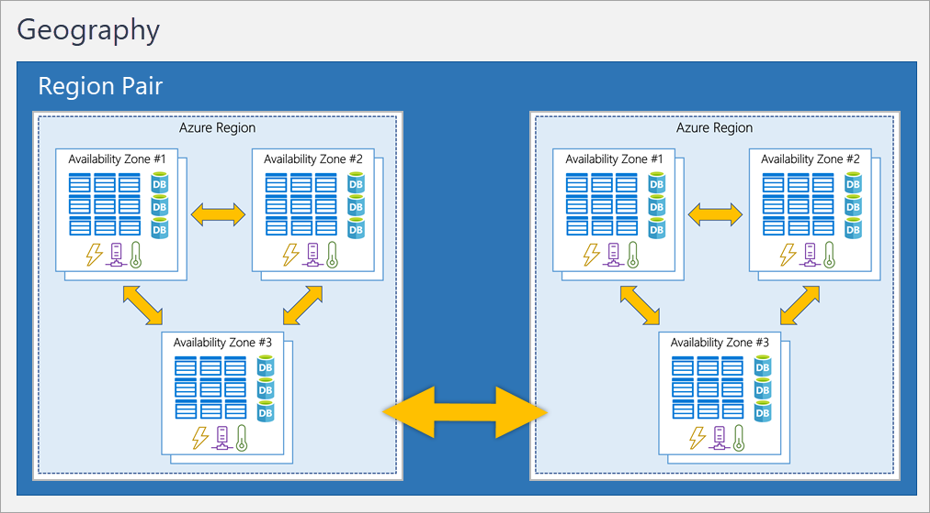
Azure Architectural Component
Region Pairs
Most Azure regions are paired with another region within the same geography (such as US, Europe, or Asia) at least 300 miles away
This approach allows for the replication of resources across a geography that helps reduce the likelihood of interruptions because of events such as natural disasters, civil unrest, power outages, or physical network outages that affect an entire region
For example, if a region in a pair was affected by a natural disaster, services would automatically fail over to the other region in its region pair.

Slide 5
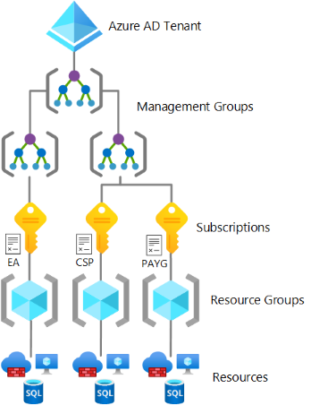
Azure subscriptions and Management Groups
Azure subscription
In Azure, subscriptions are a unit of management, billing, and scale.
Similar to how resource groups are a way to logically organize resources, subscriptions allow you to logically organize your resource groups and facilitate billing.
Using Azure requires an Azure subscription
An account can have multiple subscriptions
There are two types of subscription boundaries that you can use
Billing boundary: This subscription type determines how an Azure account is billed for using Azure – E.g. Pay As You Go, CSP, Enterprise Agreement
Access control boundary: Azure applies access-management policies at the subscription level

Slide 6
Azure subscriptions and Management Groups
Azure Management Groups
Azure management groups provide a level of scope above subscriptions. You organize subscriptions into containers called management groups and apply governance conditions to the management groups.
All subscriptions within a management group automatically inherit the conditions applied to the management group
Management groups can be nested.

Slide 7
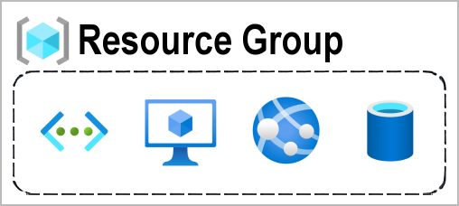
Azure resources and resource groups
A resource is the basic building block of Azure. Anything you create, provision, deploy, etc. is a resource. Virtual Machines (VMs), virtual networks, databases, cognitive services, etc. are all considered resources within Azure.
Resource groups are logical groupings of resources. When you create a resource, you’re required to place it into a resource group.
When you apply an action to a resource group, that action will apply to all the resources within the resource group. If you delete a resource group, all the resources will be deleted. If you grant or deny access to a resource group, you’ve granted or denied access to all the resources within the resource group.

Slide 8
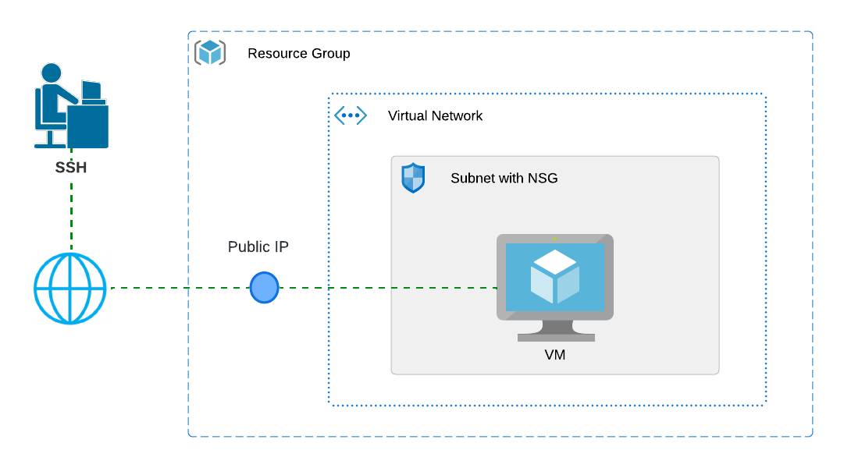
Azure Compute Services
Azure Virtual Machines
With Azure Virtual Machines (VMs), you can create and use VMs in the cloud.
VMs provide infrastructure as a service (IaaS) in the form of a virtualized server and can be used in many ways. Just like a physical computer, you can customize all of the software running on your VM
An Azure VM gives you the flexibility of virtualization without having to buy and maintain the physical hardware that runs the VM
However, as an IaaS offering, you still need to configure, update, and maintain the software that runs on the VM

Slide 9
Azure Compute Services
Demo: Create a Windows/Linux VM in Azure and confirm access to the VM, Deploy sample website
Step by step instructions:
Create a Windows VM in Azure Portal : https://learn.microsoft.com/en-us/azure/virtual-machines/windows/quick-create-portal
Create a Linux VM in Azure Portal : https://learn.microsoft.com/en-us/azure/virtual-machines/linux/quick-create-portal?tabs=ubuntu

Slide 10
Azure Compute Services
Scale VMs in Azure
You can run single VMs for testing, development, or minor tasks. Or you can group VMs together to provide high availability, scalability, and redundancy. Azure can also manage the grouping of VMs for you with features such as scale sets and availability sets.
Virtual machine scale sets
Virtual machine scale sets let you create and manage a group of identical, load-balanced VMs
Scale sets allow you to centrally manage, configure, and update a large number of VMs in minutes
The number of VM instances can automatically increase or decrease in response to demand, or you can set it to scale based on a defined schedule
Virtual machine scale sets also automatically deploy a load balancer to make sure that your resources are being used efficiently. With virtual machine scale sets, you can build large-scale services for areas such as compute, big data, and container workloads.

Slide 11
Azure Compute Services
Virtual machine availability sets
Availability sets are designed to ensure that VMs stagger updates and have varied power and network connectivity, preventing you from losing all your VMs with a single network or power failure.
Availability sets groups VMs in two ways: update domain and fault domain.
Update domain: The update domain groups VMs that can be rebooted at the same time. This allows you to apply updates while knowing that only one update domain grouping will be offline at a time. All of the machines in one update domain will be updated.
Fault domain: The fault domain can be considered as a rack which has common power source and network switch. By default, an availability set will split your VMs across up to three fault domains. This helps protect against a physical power or networking failure by having VMs in different fault domains (thus being connected to different power and networking resources).

Slide 12
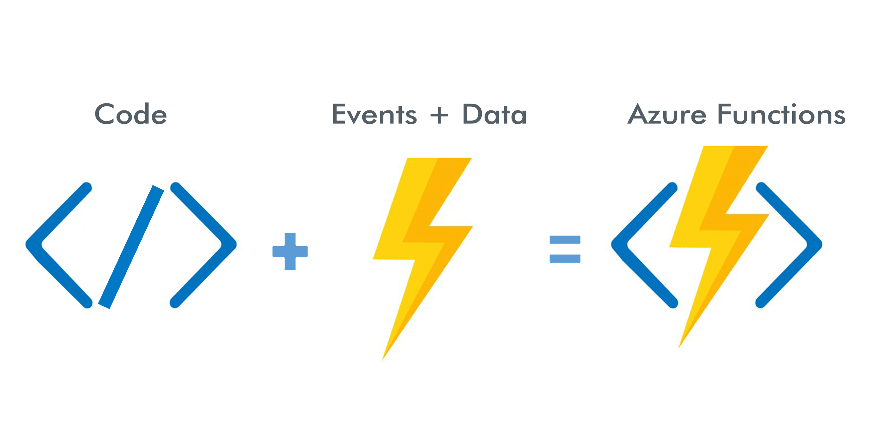
Azure Compute Services
Azure Functions
Azure Functions is an event-driven, serverless compute option that doesn’t require maintaining virtual machines or containers.
If you build an app using VMs or containers, those resources have to be “running” in order for your app to function. With Azure Functions, an event wakes the function, alleviating the need to keep resources provisioned when there are no events.
Functions are commonly used when you need to perform work in response to an event (often via a REST request), timer, or message from another Azure service, and when that work can be completed quickly, within seconds or less.
Functions scale automatically based on demand. Azure Functions runs your code when it's triggered and automatically deallocates resources when the function is finished. In this model, you're only charged for the CPU time used while your function runs.

Slide 13
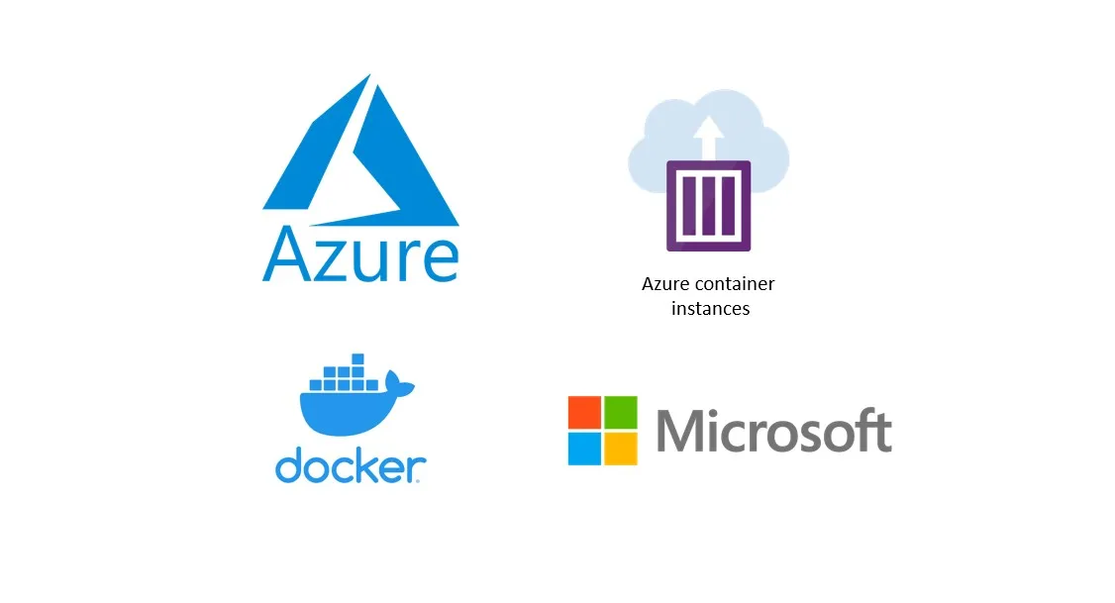
Azure Compute Services
Azure Containers
A container is a unit of software that packages code and its dependencies, so the application runs quickly and reliably across computing environments
Much like running multiple virtual machines on a single physical host, you can run multiple containers on a single physical or virtual host. Unlike virtual machines, you don't manage the operating system for a container
Containers are lightweight and designed to be created, scaled out, and stopped dynamically.
One of the most popular container engines is Docker, which is supported by Azure.
Azure Container Instances offer the fastest and simplest way to run a container in Azure. Azure Container Instances are example of PaaS offering.

Slide 14
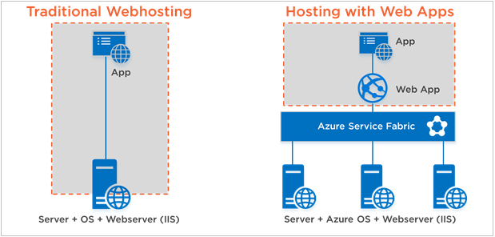
Azure application hosting options
Azure App Service
Azure App Service is an HTTP-based service for hosting web applications, REST APIs, and mobile back ends. It supports multiple languages, including .NET, .NET Core, Java, Ruby, Node.js, PHP, or Python
It offers automatic scaling and high availability. App Service supports Windows and Linux. It enables automated deployments from GitHub, Azure DevOps, or any Git repo to support a continuous deployment model.
The App Service is deployed on to an App Service Plan which would define the compute and Storage Capacity needed for the App Service

Slide 15
Azure application hosting options
Demo: Create an App Service in Azure and host sample website
Step by step instructions:
Deploy an ASP.NET web app: https://learn.microsoft.com/en-us/azure/app-service/quickstart-dotnetcore?tabs=net70&pivots=development-environment-vs
Deploy a PHP Web App: https://learn.microsoft.com/en-us/azure/app-service/quickstart-php?tabs=cli&pivots=platform-linux

Slide 16
Azure Networking Services
Azure Virtual Networking(VNET)
Azure Virtual Network is the fundamental building block for your private network in Azure. A virtual network enables many types of Azure resources, such as Azure Virtual Machines (VM), to securely communicate with each other, the internet, and on-premises networks
When you set up a virtual network, you define a private IP address space by using either public or private IP address ranges. The IP range only exists within the virtual network and isn't internet routable. You can divide that IP address space into subnets and allocate part of the defined address space to each named subnet
You can inter-connect multiple VNETs by using VNET peering or VNET to VNET connection using virtual network gateway device
You can connect to your on-premises networks privately using VPN Tunnels(site to site or point to site) or ExpressRoute
To control traffic flow, you may deploy Firewalls or use Network Security Groups

Slide 17
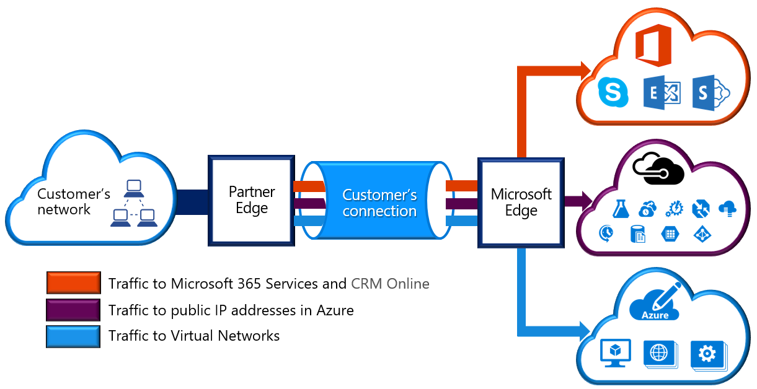
Azure Networking Services
Azure Express Route
extends on-premises networks into Azure over a private connection that is facilitated by a connectivity provider.

Slide 18
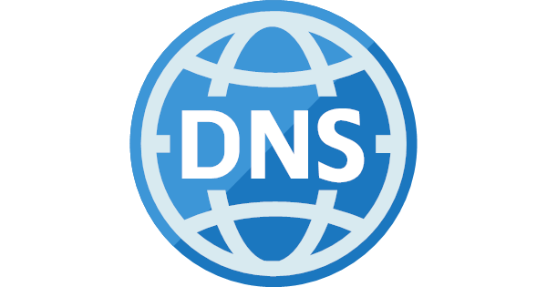
Azure Networking Services
Azure DNS
Azure DNS is a hosting service for DNS domains that provides name resolution by using Microsoft Azure infrastructure.
By hosting your domains in Azure, you can manage your DNS records using the same credentials, APIs, tools, and billing as your other Azure services.
Azure DNS also supports private DNS domains. This feature allows you to use your own custom domain names in your private virtual networks, rather than being stuck with the Azure-provided names.

Slide 19
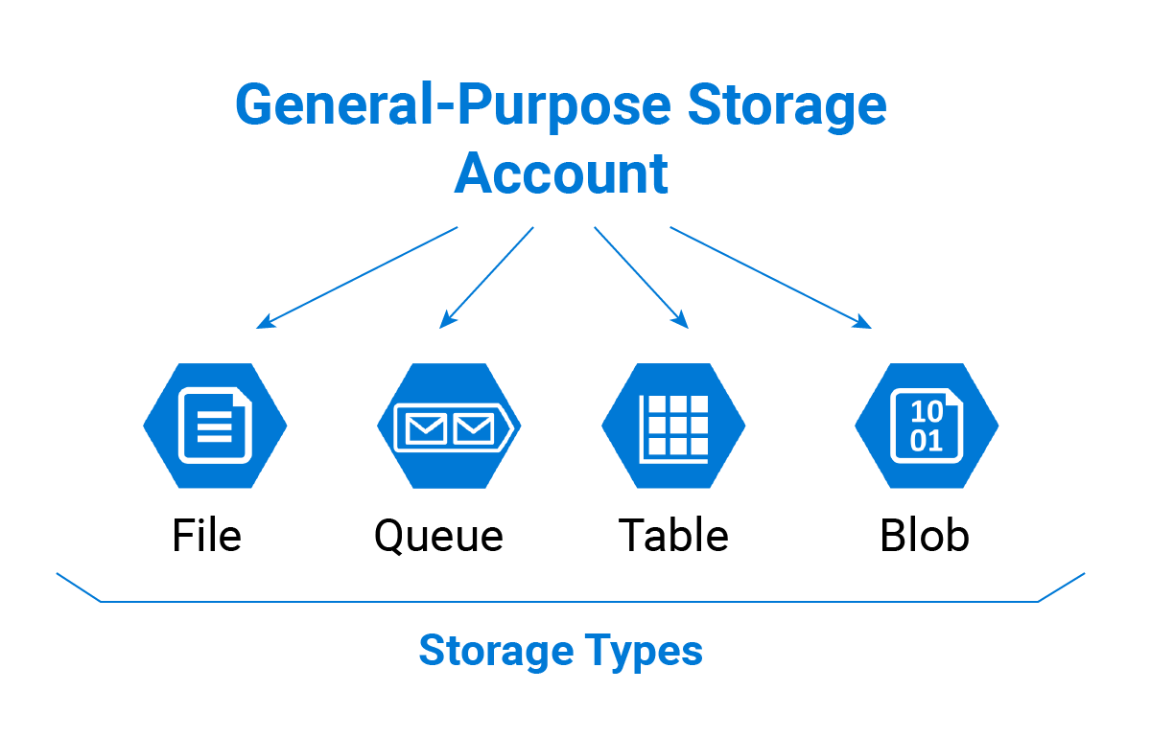
Azure Storage Services
Azure storage account
Azure Storage Account is a cloud based, web-based storage service which is secure, highly available, durable, and massively scalable and accessible over HTTP or HTTPS.
Storage Account must have a globally unique name
Azure Storage Account support four Azure data storage objects Blob, File, Table and Queue
Azure Storage Account supports six replication options, Namely, Locally redundant storage (LRS), Geo-redundant storage (GRS), Read-access geo-redundant storage (RA-GRS), Zone-redundant storage (ZRS), Geo-zone-redundant storage (GZRS), Read-access geo-zone-redundant storage (RA-GZRS)

Slide 20
Azure Storage Services
Demo: Create an Azure storage account and upload a BLOB, access the BLOB using endpoint
Step by step instructions:
Create a Storage Account: https://learn.microsoft.com/en-us/azure/storage/common/storage-account-create?tabs=azure-portal
Upload, download, and list blobs with the Azure portal: https://learn.microsoft.com/en-us/azure/storage/blobs/storage-quickstart-blobs-portal

Slide 21
Azure Storage Services
Azure Data Migration Options
Azure supports both real-time migration of infrastructure, applications, and data using Azure Migrate as well as asynchronous migration of data using Azure Data Box
Azure Data Box
Azure Data Box is a physical migration service that helps transfer large amounts of data in a quick, inexpensive, and reliable way.
The secure data transfer is accelerated by shipping you a proprietary Data Box storage device that has a maximum usable storage capacity of 80 terabytes.
The Data Box is transported to and from your datacenter via a regional carrier. A rugged case protects and secures the Data Box from damage during transit.

Slide 22
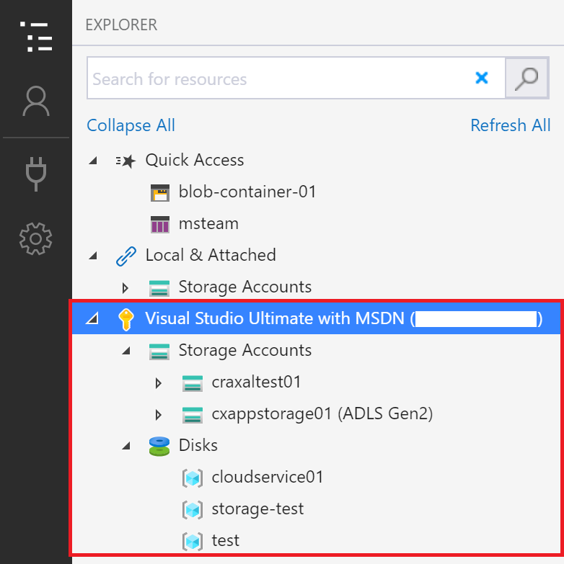
Azure Storage Services
Azure file movement options
AzCopy
AzCopy is a command-line utility that you can use to copy blobs or files to or from your storage account. With AzCopy, you can upload files, download files, copy files between storage accounts
Azure Storage Explorer
Azure Storage Explorer is a standalone app that provides a graphical interface to manage files and blobs in your Azure Storage Account. It works on Windows, macOS, and Linux operating systems. With Storage Explorer, you can upload to Azure, download from Azure, or move between storage accounts.
Azure File Sync
Azure File Sync is a tool that lets you centralize your file shares in Azure Files and keep the flexibility, performance, and compatibility of a Windows file server. It’s almost like turning your Windows file server into a miniature content delivery network. Once you install Azure File Sync on your local Windows server, it will automatically stay bi-directionally synced with your files in Azure.

Slide 23
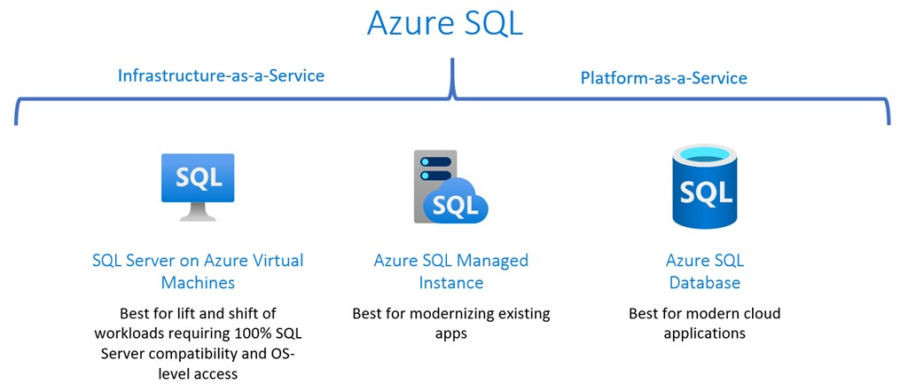
Azure Database Services
SQL Database
SQL Database is a PaaS deployment option of Azure SQL that abstracts both the OS and the SQL Server instance away from users.
This deployment option allows you to just get a database and start developing applications. SQL Database supports scenarios that require unlimited database storage (hyperscale) and autoscaling for unpredictable workloads (serverless).
SQL Database has the industry's highest availability SLA. It provides other intelligent capabilities related to monitoring and performance, partly because Microsoft manages instances.
Azure also has other SQL Deployment options like SQL in Azure VM and SQL Managed Instance
Azure also supports Cosmos DB, MySQL and PostgreSQL

Slide 24
Azure Database Services
Demo: Create Azure SQL Database instance
Step by step instructions:
Create a single database - Azure SQL Database: https://learn.microsoft.com/en-us/azure/azure-sql/database/single-database-create-quickstart?view=azuresql-db&tabs=azure-portal

Slide 25
Thank You.

